Slide 2


Slide 3
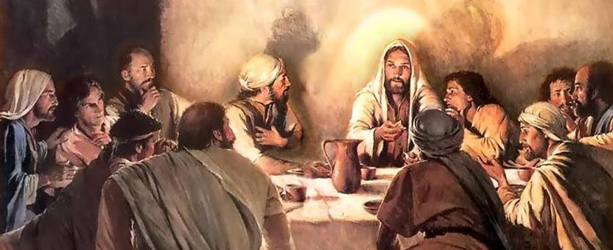
LUKE 15:1,2

Slide 4
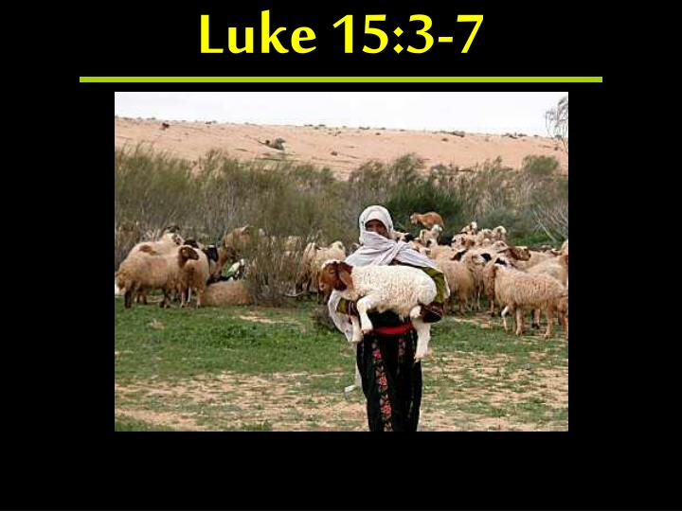

Slide 5
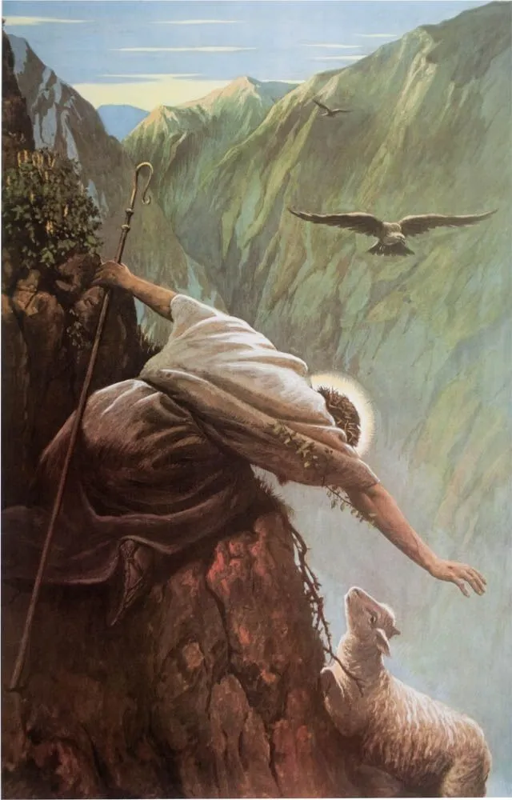
GOD SEEKS THE LOST
Matthew 15:22-24
Leaves the 99 in safety to seek lost
God Doesn’t Rest
2 Peter 3:9

Slide 6
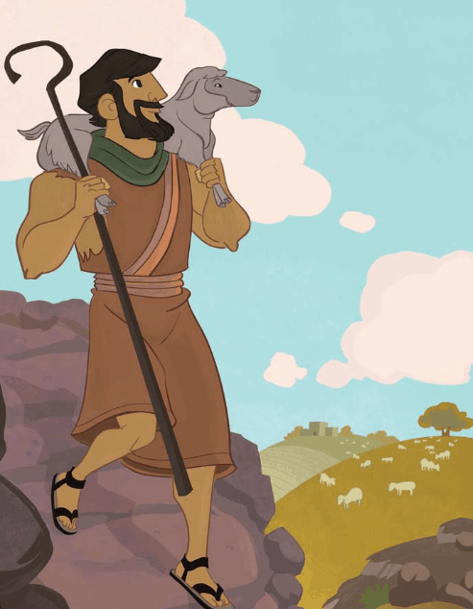
GOD REJOICES
Luke 15:7
More Joy in Heaven over a Sinner who repents
Than over a multitude who need no repentance!

Slide 7
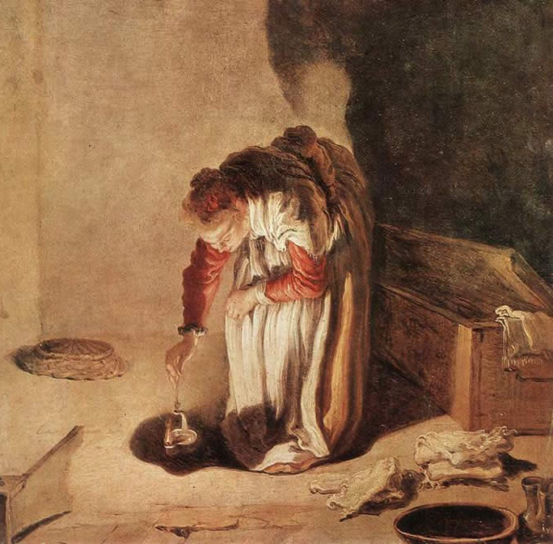
THE PARABLE OF THE LOST COIN
Luke 15:8-10
10 Silver coins about 10 day’s wages
Misplaced one coin – a day’s wage!
Longer it was lost, less chance of being found
Lights a lamp – sweeps house carefully
Neighbors asked to share her joy!

Slide 8
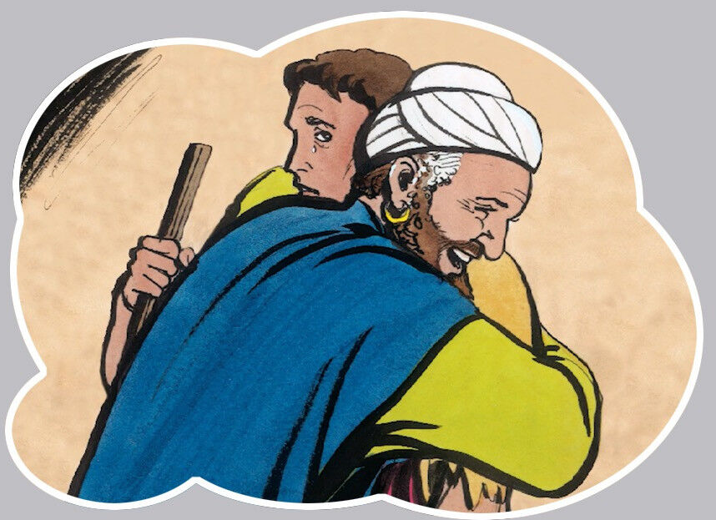
THE PARABLE OF THE LOST SON
Luke 15:11-32
Younger took his inheritance
Wasted it on loose living
Came to his senses and realized his father’s servants were treated better
Father saw him from a distance and ran to greet him
Rejoiced and held a feast in celebration

Slide 9
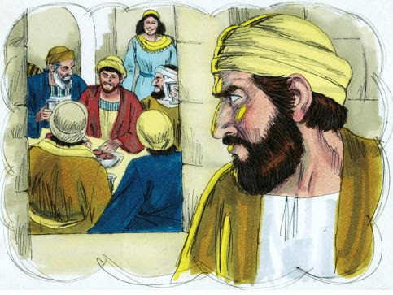
THE PARABLE OF THE LOST SON
Luke 15:25-32
Older son had been working in the field and wonder what the commotion was about
When he found out he became angry and refused to join
Father entreated him with a message of life from death

Slide 10
SOME POINTS OF COMPARISON
One who lost something – rich, poor, father
Relative worth of the thing lost – 1/100, 1/10, 1/2
First two illustrate salvation from God’s perspective – compassion for lost, value of human soul – Last illustrates this from man’s perspective and need to come to God
How do we feel about the lost?

